Slide 1
JAVA
UNIT 1

Slide 2
History of JAVA
1) James Gosling, Mike Sheridan, and Patrick Naughton initiated the Java language project in June 1991. The small team of sun engineers called Green Team.
2) Originally designed for small, embedded systems in electronic appliances like set-top boxes.
3) Firstly, it was called "Greentalk" by James Gosling, and file extension was .gt .
4) After that, it was called Oak and was developed as a part of the Green project.

Slide 3
History of JAVA
5) Why Oak? Oak is a symbol of strength and chosen as a national tree of many countries like U.S.A., France, Germany, Romania, etc.
6) In 1995, Oak was renamed as "Java" because it was already a trademark by Oak Technologies.
8) Java is an island of Indonesia where first coffee was produced (called java coffee).
9) Notice that Java is just a name, not an acronym.
10) Initially developed by James Gosling at Sun Microsystems (which is now a subsidiary of Oracle Corporation) and released in 1995.

Slide 4
JAVA Environment
Below are the environment settings for both Linux and Windows. JVM, JRE and JDK all three are platform dependent because configuration of each Operating System is different. But, Java is platform independent.
There are few things which must be clear before setting up the environment
JDK(Java Development Kit) : JDK is intended for software developers and includes development tools such as the Java compiler, Javadoc, Jar, and a debugger.
JRE(Java Runtime Environment) : JRE contains the parts of the Java libraries required to run Java programs and is intended for end users. JRE can be view as a subset of JDK. JVM is part of JRE. JVM (Java Virtual Machine) is an abstract machine. It is a specification that provides runtime environment in which java bytecode can be executed. JVMs are available for many hardware and software platforms.

Slide 5
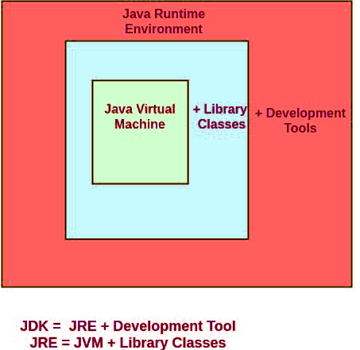

Slide 6
Java’s Magic: The Bytecode
Bytecode is the intermediate representation of Java programs.
As soon as a java program is compiled, java bytecode is generated in the form of a .class file. With the help of java bytecode we achieve platform independence in java.

Slide 7
How does it works?
When we write a program in Java, firstly, the compiler compiles that program and a bytecode is generated for that piece of code.
When we wish to run this .class file on any other platform, we can do so. After the first compilation, the bytecode generated is now run by the Java Virtual Machine(JVM) and not the processor in consideration. This essentially means that we only need to have basic java installation on any platforms that we want to run our code on.
Resources required to run the bytecode are made available by the Java Virtual Machine, which calls the processor to allocate the required resources.

Slide 8
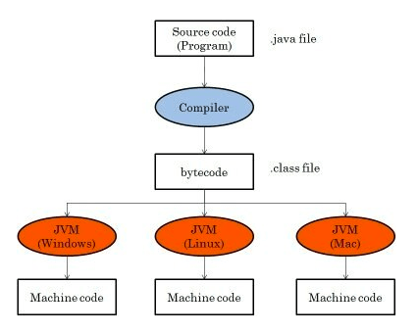

Slide 9
Java Buzzwords
Simple
Secure
Portable
Object-oriented
Robust
Multithreaded
Architecture-neutral/portable/ platform independent
Interpreted + compiled
High performance
Distributed

Slide 10
Simple
Java was designed to be easy for the professional programmer to learn and use effectively. Assuming that you have some programming experience, you will not find Java hard to master.
If you already understand the basic concepts of object-oriented programming, learning Java will be even easier. Best of all, if you are an experienced C++ programmer, moving to Java will require very little effort. Because Java inherits the C/C++ syntax and many of the object oriented features of C++, most programmers have little trouble learning Java.

Slide 11
Secure
The fact that a Java program is executed by the JVM also helps to make it secure. Because the JVM is in control, it can contain the program and prevent it from generating side effects outside of the system.

Slide 12
Portability/Platform independence
Solution is Bytecode.(already discussed, Refer to slides 8,9,10)

Slide 13
Object-Oriented
Object-oriented programming aims to implement real-world entities like inheritance, hiding, polymorphism, etc in programming.
The main aim of OOP is to bind together the data and the functions that operate on them so that no other part of the code can access this data except that function.

Slide 14
Robust
Java is robust because :
It is a Strictly typed language. Some kind of explicit type conversion would be necessary if the data types are not related which in other languages is done implicitly.

Slide 15
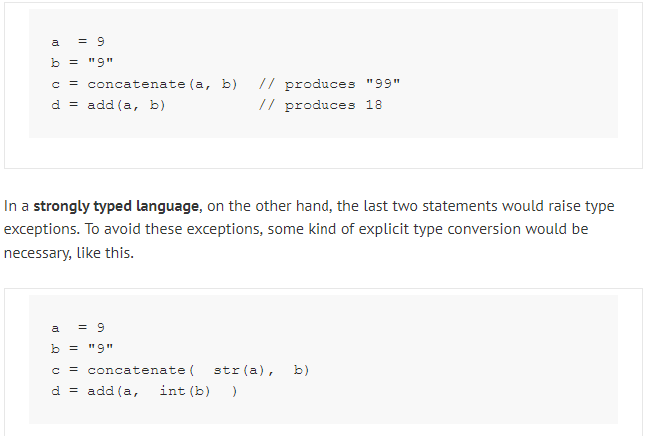
Strictly typed

Slide 16
Multithreaded
Multithreading in java is a process of executing multiple threads simultaneously.
A thread is a lightweight sub-process, the smallest unit of processing. Multiprocessing and multithreading, both are used to achieve multitasking.
However, we use multithreading than multiprocessing because threads use a shared memory area. They don't allocate separate memory area so saves memory, and context-switching between the threads takes less time than process.
Java Multithreading is mostly used in games, animation, etc.

Slide 17
High Performance
As described earlier, Java enables the creation of cross-platform programs by compiling into an intermediate representation called Java bytecode. This code can be executed on any system that implements the Java Virtual Machine. Most previous attempts at cross-platform solutions have done so at the expense of performance.
As explained earlier, the Java bytecode was carefully designed so that it would be easy to translate directly into native machine code for very high performance by using a just-in-time(JIT) compiler. Java run-time systems that provide this feature lose none of the benefits of the platform-independent code.

Slide 18
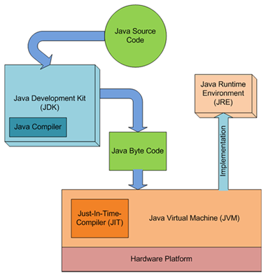

Slide 19
Distributed
Java is designed for the distributed environment of the Internet, because it handles TCP/IP protocols. In fact, accessing a resource using a URL is not much different from accessing a file.

Slide 20
Object-Oriented Programming
Object-Oriented Programming is a paradigm that provides many concepts, such as inheritance, data binding, polymorphism, etc.
Simula is considered the first object-oriented programming language. The programming paradigm where everything is represented as an object is known as a truly object-oriented programming language.
Smalltalk is considered the first truly object-oriented programming language.
The popular object-oriented languages are Java, C#, PHP, Python, C++, etc.
The main aim of object-oriented programming is to implement real-world entities, for example, object, classes, abstraction, inheritance, polymorphism, etc.

Slide 21
OOP: Two paradigms
Procedure oriented
Object oriented
Difference?

Slide 22
Object-Oriented Programming
Object-Oriented Programming is a methodology or paradigm to design a program using classes and objects. It simplifies software development and maintenance by providing some concepts:
Object
Class
Inheritance
Polymorphism
Abstraction
Encapsulation

Slide 23
Object
Any entity that has state and behavior is known as an object. For example, a chair, pen, table, keyboard, bike, etc. It can be physical or logical.
An Object can be defined as an instance of a class. An object contains an address and takes up some space in memory. Objects can communicate without knowing the details of each other's data or code. The only necessary thing is the type of message accepted and the type of response returned by the objects.
Example: A dog is an object because it has states like color, name, breed, etc. as well as behaviors like wagging the tail, barking, eating, etc.

Slide 24
Class
Collection of objects is called class. It is a logical entity.
A class can also be defined as a blueprint from which you can create an individual object.
Class doesn't consume any space.

Slide 25
Inheritance
When one object acquires all the properties and behaviors of a parent object, it is known as inheritance.
It provides code reusability.
It is used to achieve runtime polymorphism.

Slide 26
Polymorphism
If one task is performed in different ways, it is known as polymorphism. For example: to convince the customer differently, to draw something, for example, shape, triangle, rectangle, etc.
In Java, we use method overloading and method overriding to achieve polymorphism.
Another example can be to speak something; for example, a cat speaks meow, dog barks woof, etc.

Slide 27
Abstraction
Hiding internal details and showing functionality is known as abstraction. For example phone call, we don't know the internal processing.
In Java, we use abstract class and interface to achieve abstraction.

Slide 28
Encapsulation
Binding (or wrapping) code and data together into a single unit are known as encapsulation. For example, a capsule, it is wrapped with different medicines.
A java class is the example of encapsulation. Java bean is the fully encapsulated class because all the data members are private here.

Slide 29
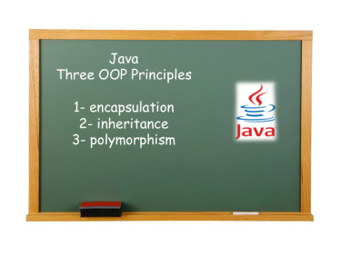
3 OOP principles

Slide 30
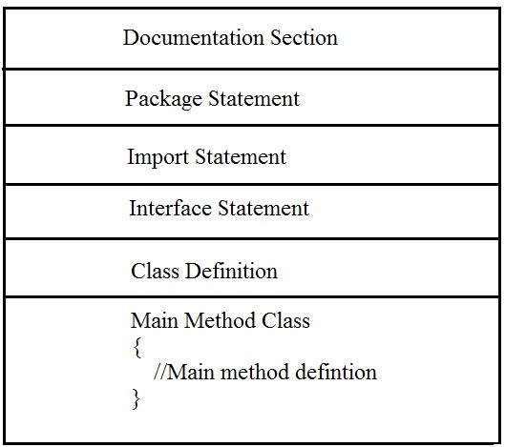
JAVA: Program structure

Slide 31
JAVA: Program structure
1. Documentation Section:
It includes the comments that improve the readability of the program.
A comment is a non-executable statement that helps to read and understand a program especially when your programs get more complex. It is simply a message that exists only for the programmer and is ignored by the compiler.
A good program should include comments that describe the purpose of the program, author name, date and time of program creation. This section is optional and comments may appear anywhere in the program.

Slide 32
Package Statement
Java allows you to group classes in a collection known as package. A package statement includes a statement that provides a package declaration. It must appear as the first statement in the source code file before any class or interface declaration. This statement is optional. For example: Suppose you write the following package declaration as the first statement in the source code file.
package employee;
This statement declares that all classes and interfaces defined in this source file are part of the employee package. Only one package declaration can appear in the source file.

Slide 33
Import Statement
Java contains many predefined classes that are stored into packages. In order to refer these standard predefined classes in your program, you need to use fully qualified name (i.e. Packagename.className). But this is a very tedious task as one need to retype the package path name along with the classname. So a better alternative is to use an import statement.
An import statement is used for referring classes that are declared in other packages. The import statement is written after a package statement but before any class definition. You can import a specific class or all the classes of the package. For example : If you want to import Date class of java.util package using import statement then write
import java.util.Date;

Slide 34
Interface Section
In the interface section, we specify the interfaces. An interface is similar to a class but contains only constants and method declarations.
Interfaces cannot be instantiated. They can only be implemented by classes or extended by other interfaces. It is an optional section and is used when we wish to implement multiple inheritance feature in the program.
interface stack { void push(int item); // Insert item into stack int pop(); // Delete an item from stack }

Slide 35
Class Section
The Class section describes the information about user-defined classes present in the program. A class is a collection of fields (data variables) and methods that operate on the fields.
Every program in Java consists of at least one class, the one that contains the main method. The main () method which is from where the execution of program actually starts and follow the statements in the order specified.
The main method can create objects, evaluate expressions, and invoke other methods and much more. On reaching the end of main, the program terminates and control passes back to the operating system.
The class section is mandatory.
After discussing the structure of programs in Java, we shall now discuss a program that displays a string Hello Java on the screen.

Slide 36
Sample program
// Program to display message on the screen Package hello; // optional
class HelloJava
{ public static void main(String args[]){ System.out.println("Hello Java"); } }

Slide 37
Public
Public: It is an Access modifier, which specifies from where and who can access the method.
Making the main() method public makes it globally available.
It is made public so that JVM can invoke it from outside the class as it is not present in the current class.

Slide 38
Static
Static: It is a keyword which is when associated with a method, makes it a class related method.
The main() method is static so that JVM can invoke it without instantiating(without creating objects) the class. This also saves the unnecessary wastage of memory which would have been used by the object declared only for calling the main() method by the JVM

Slide 39
Void
Void: It is a keyword and used to specify that a method doesn’t return anything.
As main()method doesn’t return anything, its return type is void.
As soon as the main() method terminates, the java program terminates too. Hence, it doesn’t make any sense to return from main() method as JVM can’t do anything with the return value of it.

Slide 40
Main()
main: It is the name of Java main method. It is the identifier that the JVM looks for as the starting point of the java program. It’s not a keyword.

Slide 41
String[] args
String[] args: It stores Java command line arguments and is an array of type java.lang.Stringclass.
Here, the name of the String array is args but it is not fixed and user can use any name in place of it.
Javac a.java
Java a this is d3it

Slide 42
System.out.println
System is a predefined class that provides access to the system which is introduced inside java lang.package. System class is a default class.
Out is a data type of print stream class that is connected to the console.
Println ( ) displays the string which is passed to it.
Method System.out.println displays its argument in the command window followed by a new-line character to position the output cursor to the beginning of the next line.

Slide 43
Whitespace
Java is a free-form language. This means that you do not need to follow any special indentation rules.
For example, the Example program could have been written all on one line or in any other strange way you felt like typing it, as long as there was at least one whitespace character between each token that was not already delineated by an operator or separator.
In java, whitespace is a space, tab, or new line.

Slide 44
Identifiers
Identifiers are used for class names, method names, and variable names.
An identifier may be any descriptive sequence of uppercase and lowercase letters, numbers or the underscore and dollar sign characters.
They must not begin with a number
Again, java is case-sensitive, so VALUE is a different identifier the Value.
Some examples of valid identifiers are:
AvgTemp count a4 $test this_is_ok
Invalid variable names include:
2count high-temp Not/ok

Slide 45
Comments
There are two types of comments defined by java.
single-line and multiline.
The single line comment begins with a //.
The multiline comment begins with /* and ends with */.

